Slide 1

Technique Validation

Slide 2
Validation
Phantom
Vials of mangenese chloride
Normal Controls
Normal T2* values are tabulated.
Poor acquisitions usually lower T2*.
Patients
Reproducibility
Round robin with validated site
Software Validation

Slide 3
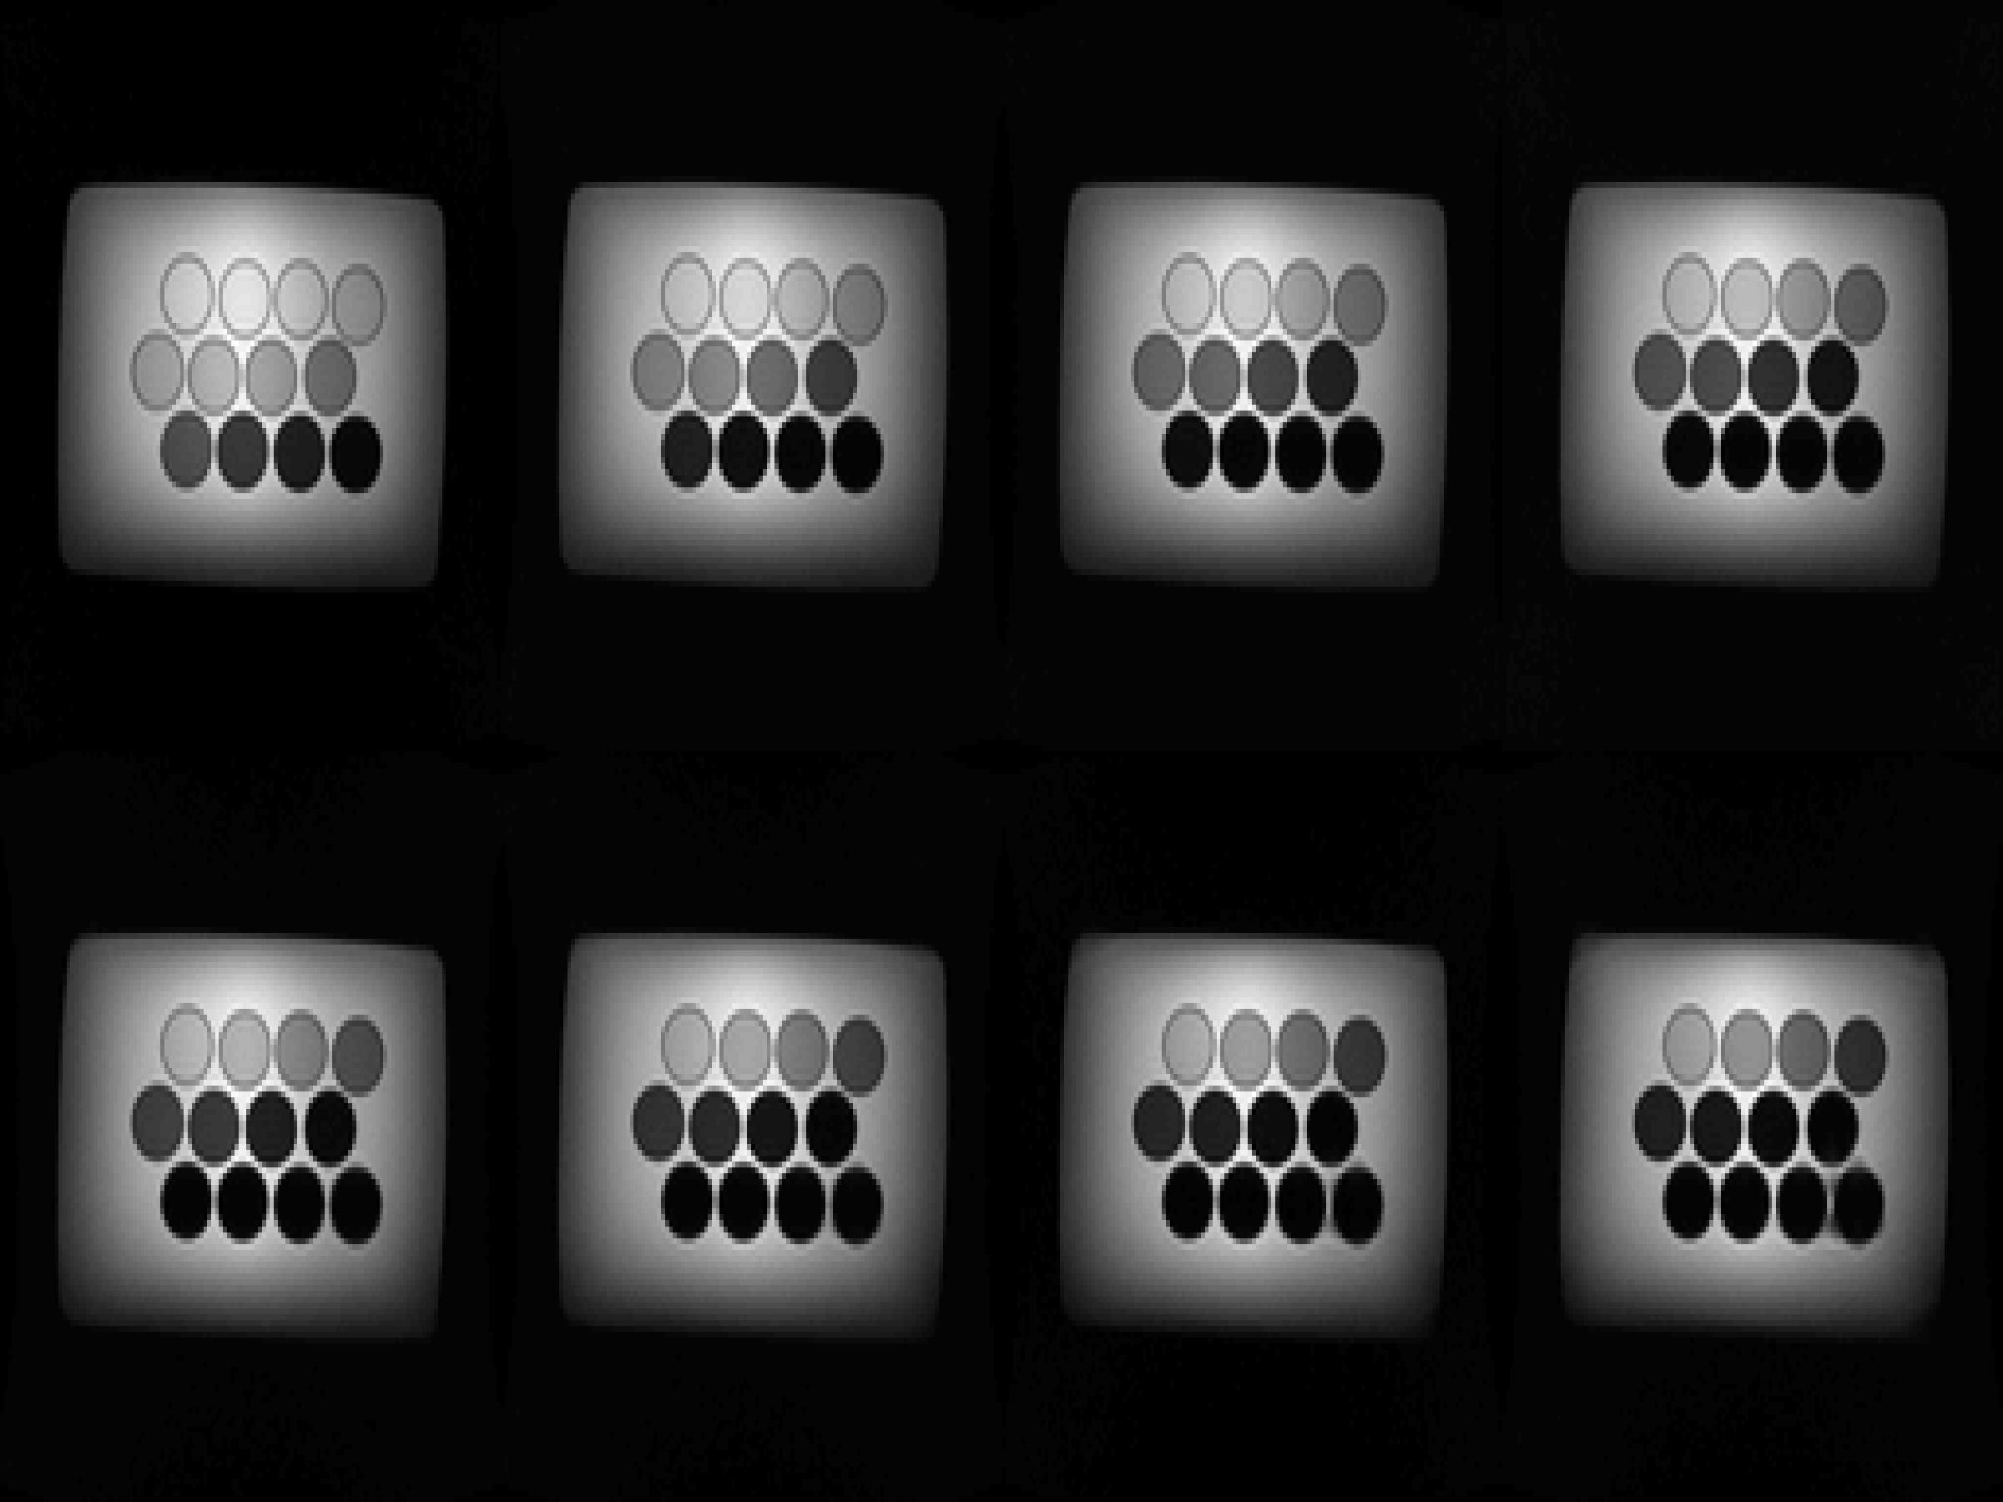
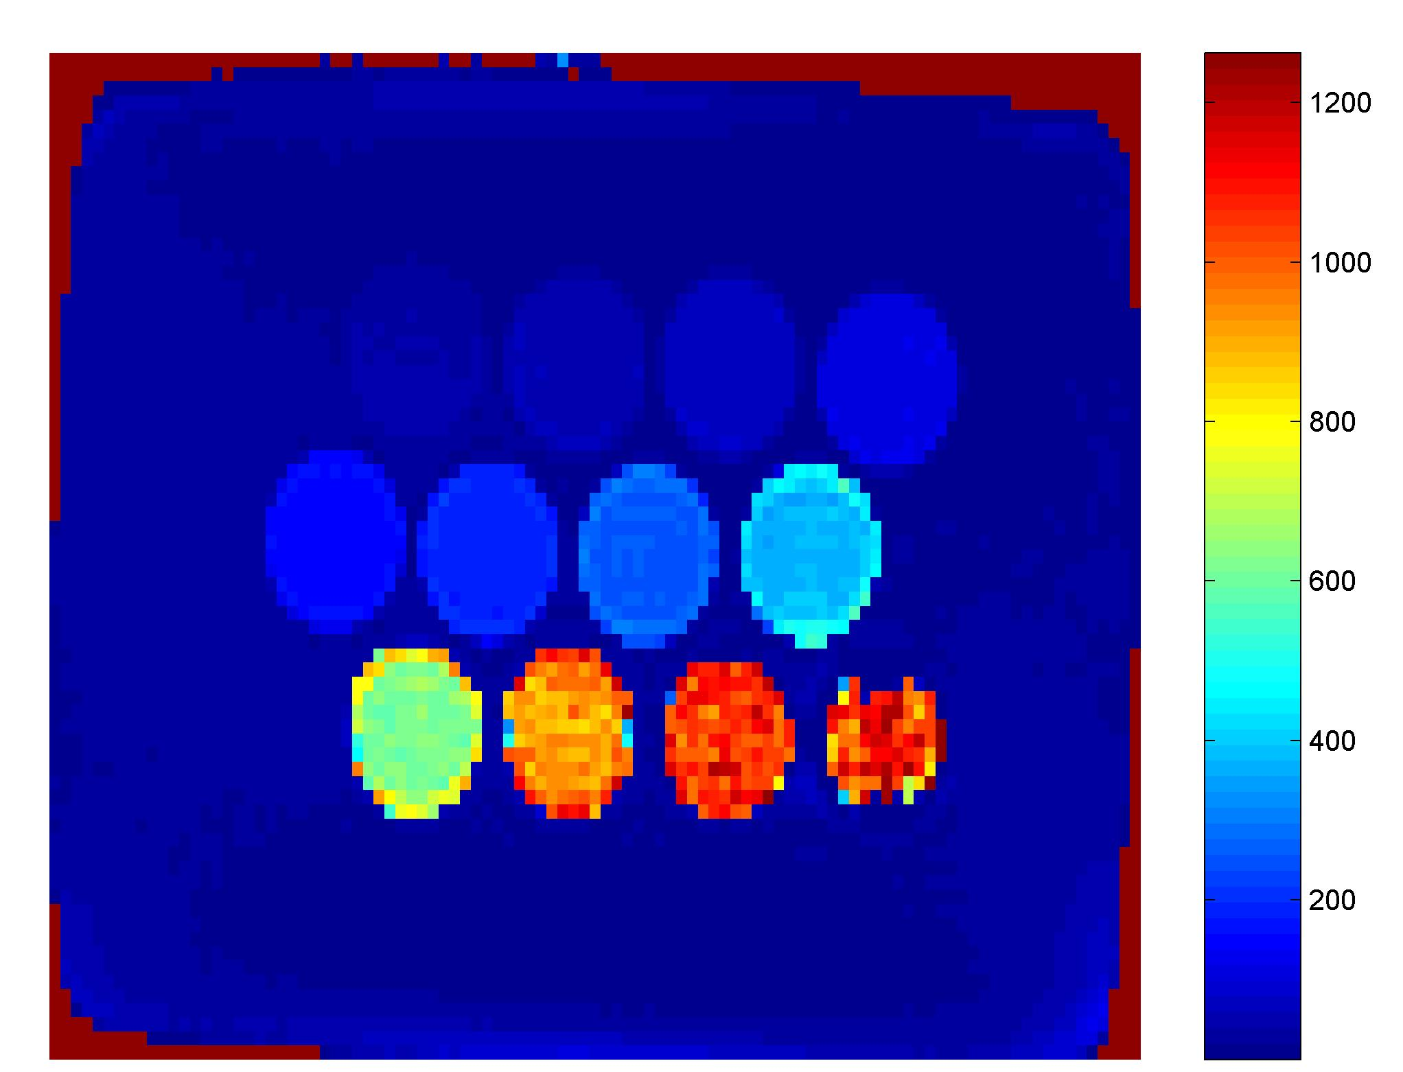
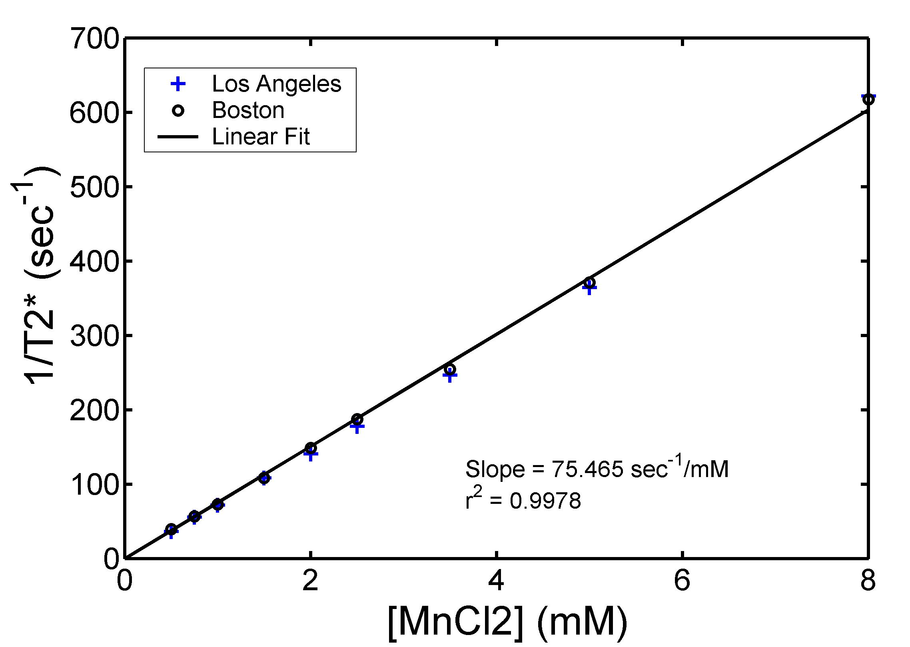
Validation: Phantom
R2* is proportional to mangenese concentration with a known scaling constant
Problems with image scaling will be picked up by phantom measurements (e.g. Philips scale slope)
Can also pick up center frequency drift

Slide 4
Building a mangenese phantom
100 ml Nalgene bottles
Use distilled water and routine grade MnCl₂.
Make dilutions appropriate to your measurement range
I use 0.25, 0.5, 0.75, 1, 1.5, 2, 3.5, 5, 8, 12, 18, 24 mM
Bath the outside of the bottles in 0.25 mM MnCl₂
R2* = 74 x [MnCl₂] + 1

Slide 5
Validation: Normal Controls
Inadequate motion compensation will cause iron independent signal loss and low T2*.

Slide 6
Validation: Round Robin
Comparison of new sites with reference site.
Limited by cost & inconvenience.
Has been done a lot. No disparities noted.

Slide 7
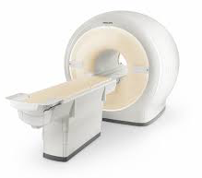
Software validation
Vendor R2* maps
?
Same ROI’s
Raw Images
Validated
Software
Common pool of images over whole range of iron
Analyze by two techniques
Compare results using Bland Altman Statistics

Slide 8
Bland Altman Statistics
A and B are two methods
Plot A-B on the y-axis vs (A+B)/2 on the x-axis
Fit a line to the results
Examine whether the variance is constant
If the variance grows with the average value, you can replace the y-axis with 2*(A-B)/(A+B)

Slide 9
CMR Tools vs Exp + Constant
Meloni et al, BJH, 2014

Slide 10

Questions?

Slide 11
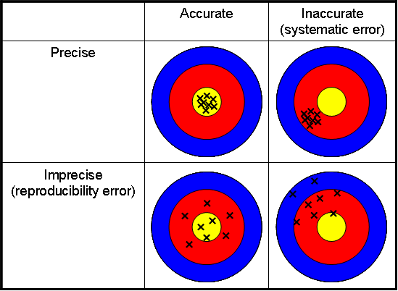
Accuracy and Precision

Slide 12
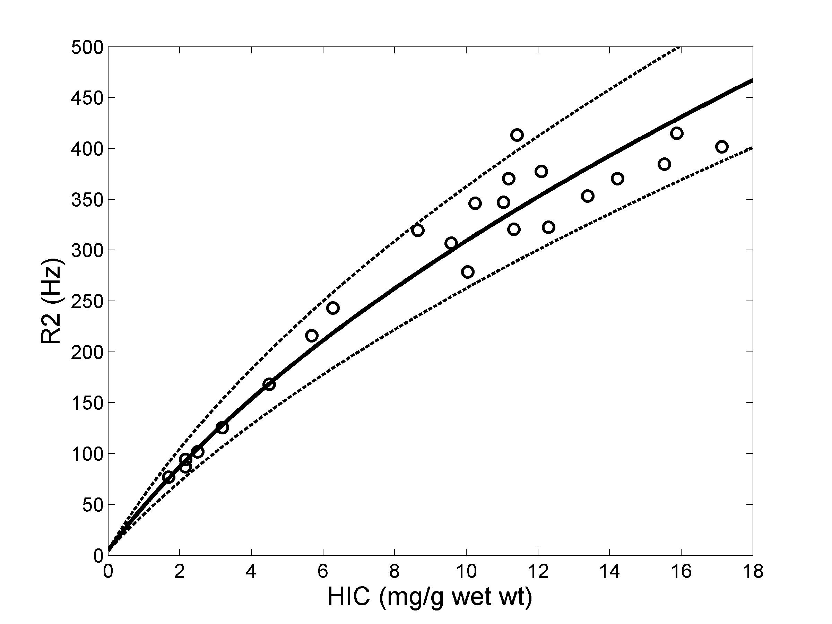
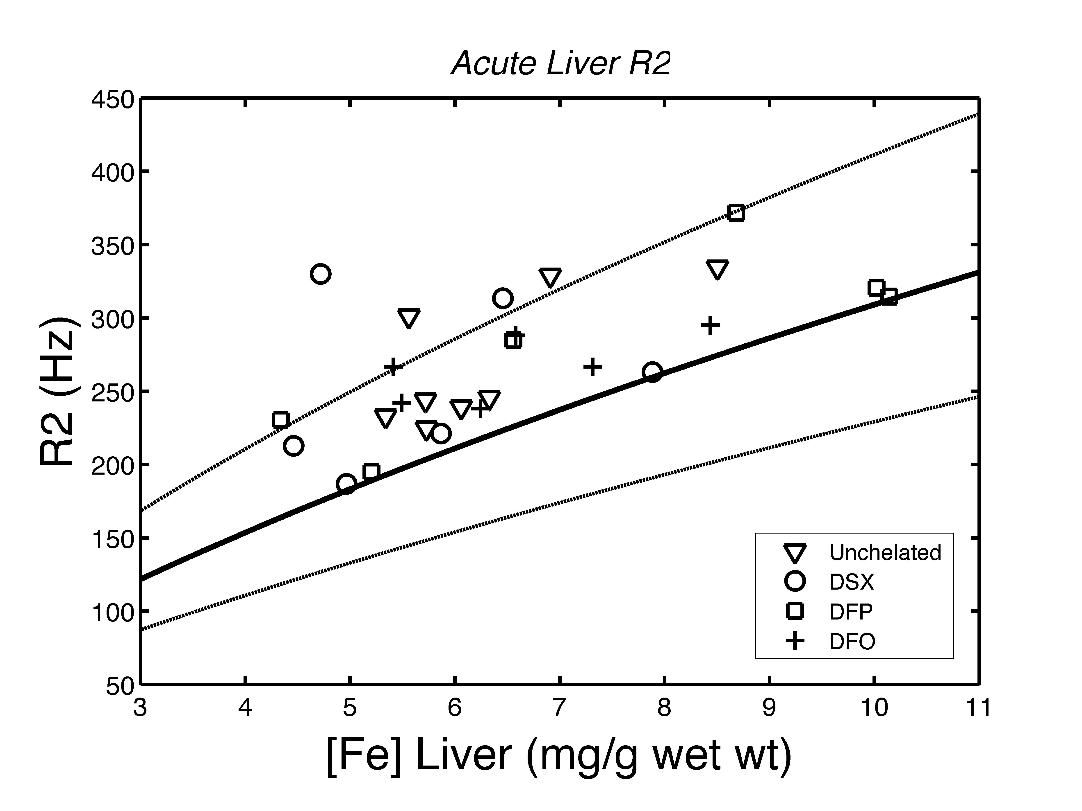
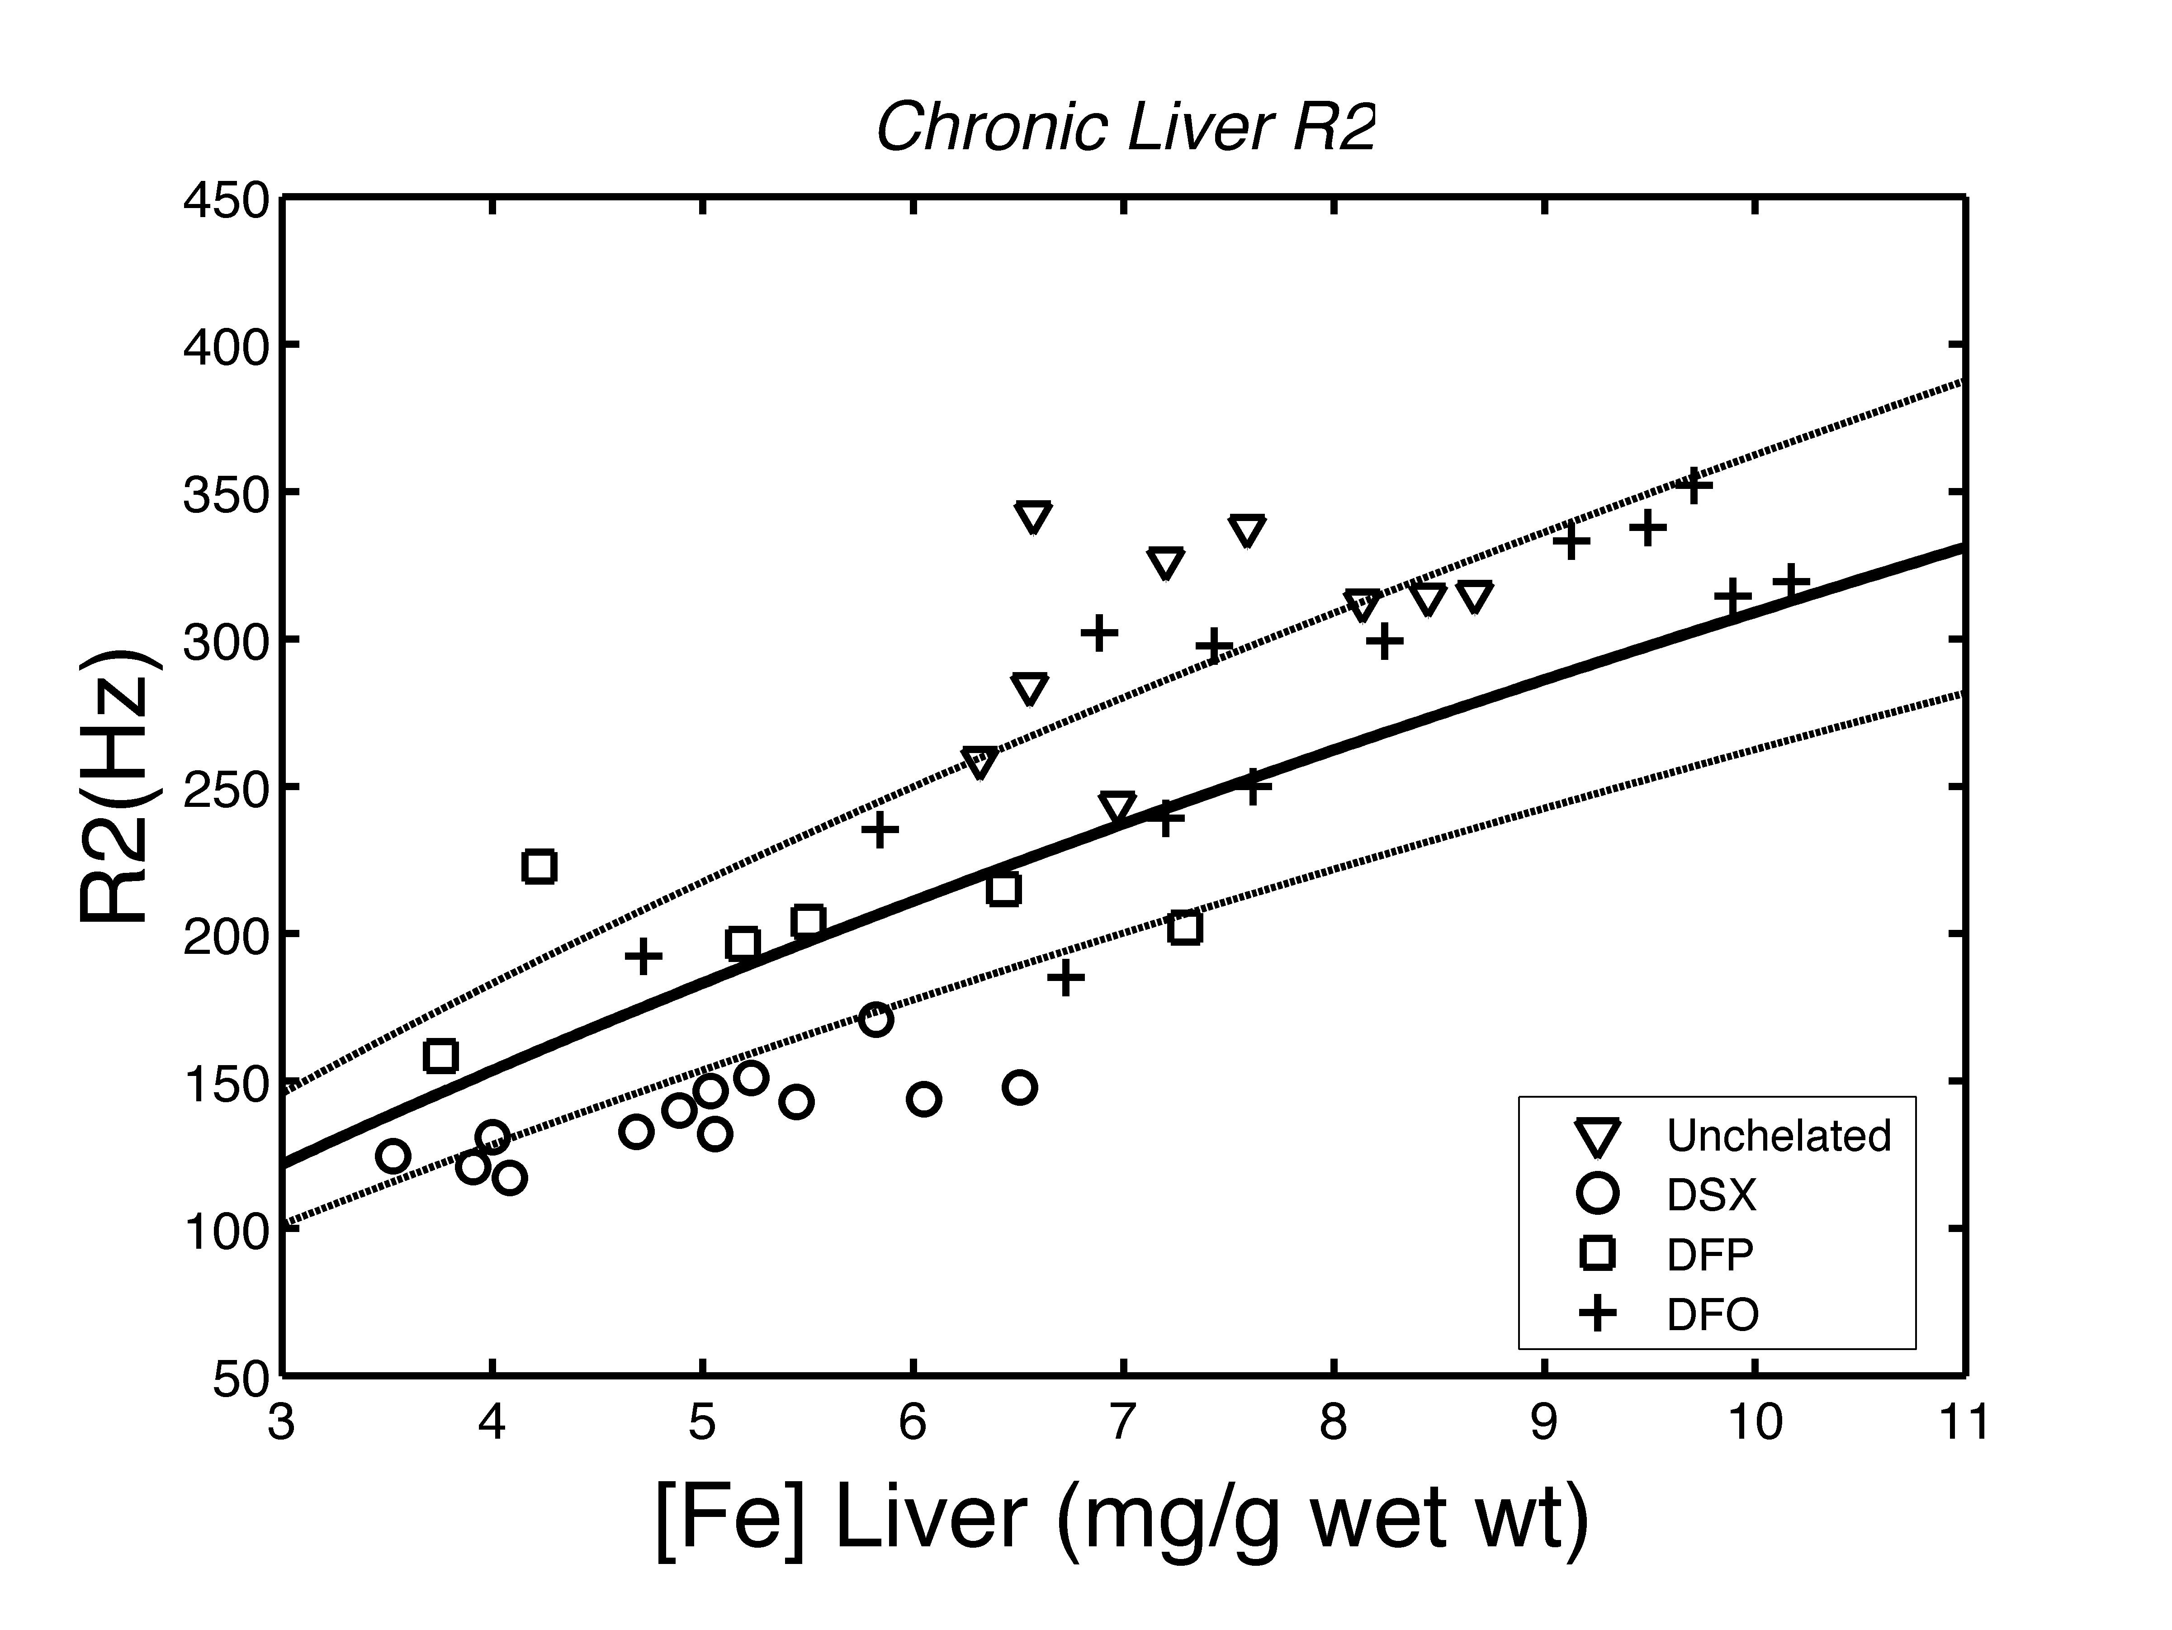
Examples from animal data
Iron loading -> MRI
Iron loading -> 1mo chelation-> MRI
Iron loading -> 3 mo chelation-> MRI
Precise & Accurate
Precise & inaccurate
Imprecise & accurate
Bias = Systematic differences from true value
Variability = Random differences from true value

Slide 13
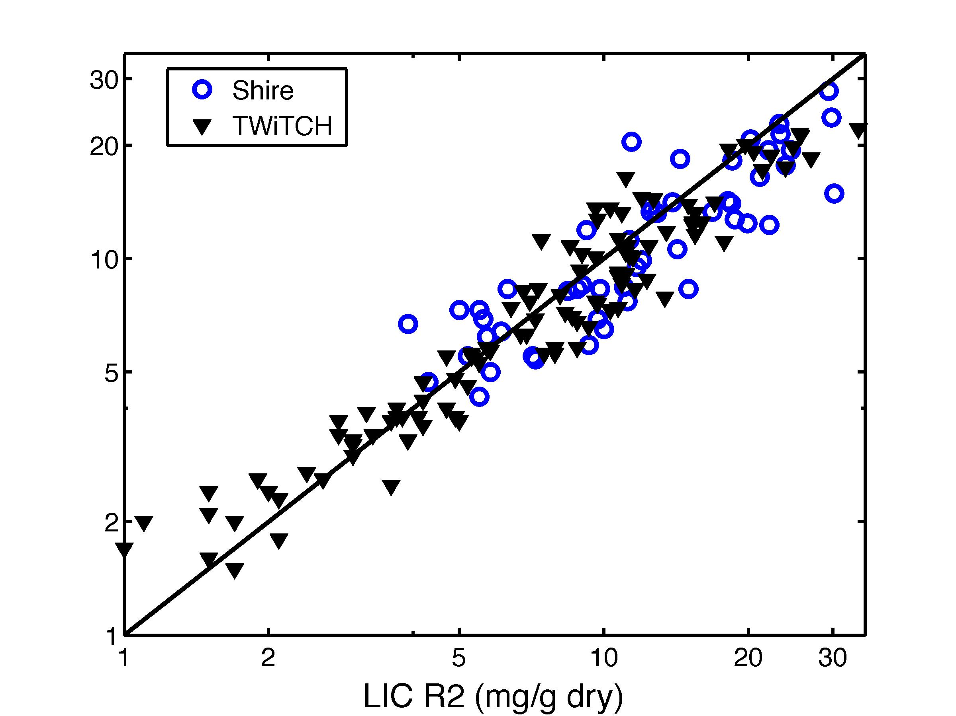
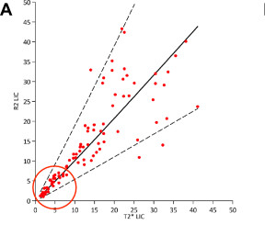
Do LIC-R2 and LIC-R2* agree ?
LIC R2*
Wood et al, AJH 89(5): 505-8, 2014
Wood et al, Blood 122:2238, 2013
Garbowski et al, JCMR 16(1): 40, 2014

Slide 14
Liver R2 calibration
B

Slide 15
Liver R2* Calibration

Slide 16
Sources of Error
Measurement Error
R2*
X
Random
Calibration Error
Patient specific
LIC

Slide 17
R2* more temporally robust
moles iron removed
moles chelator/valence
Iron chelating efficiency (ICE) =
ICE ≈ transfusional iron intake – Δ total body iron
total drug consumed
≈ transfusional iron intake – 10.6 x ΔLIC
total drug consumed
If our measurement of LIC is good, the following conditions should be met:
ICE > 0 LIC cannot increase more than transfusional iron given
ICE < 1 Chelator can’t remove more iron than it has binding sites
c) ICE (interval 1) ≈ ICE (Interval 2) Bioavailability should be stable over time
Wood et al, MRI (in Press)

Slide 18
How good would liver biopsy do ?
We repeated the same comparisons using simulated biopsy, LIC_{BX} = True LIC + assay error + sampling error
Iron loading and drug use identical to real patients.
Bx
Wood et al, MRI (In Press)

Slide 19
Summary
LIC by R2 and R2* are both superb ways to track changes in total body iron and are better than biopsy.
Both R2 and R2* are indirect measures of iron and have patient-specific calibration errors.
These increase disagreement between LIC-R2 and LIC-R2* but tend to cancel in longitudinal analysis.
Ferriscan R2 overestimates LIC at very high iron concentration but is accurate for LIC < 25 or 30.

Slide 20
Questions?

